Slide 1


COMM 2010 Financial Accounting

Slide 2
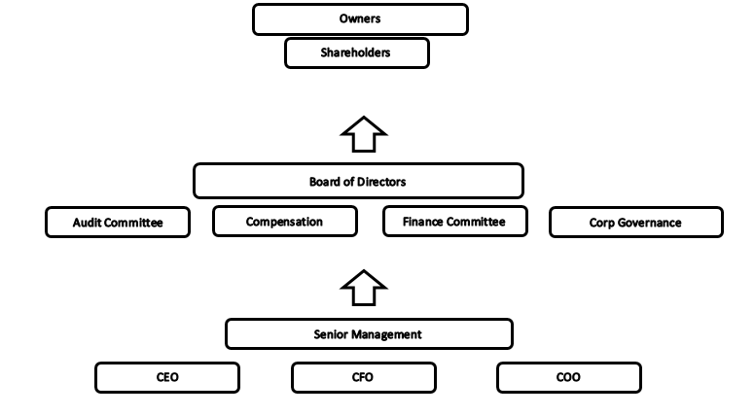
Overview of Financial Reporting
Financial Reporting Process
Financial Reporting Process: language used to compile and communicate finical information to external and internal stakeholders
Management
Shareholders
Banks
Suppliers
Employees
Competitors
Competitors
Public
Government

Slide 3
Key Players
Management
Independent Auditors
Board of Directors

Slide 4
Characteristics of Accounting Information
Relevant and Representationally Faithful
Realization:
Recognition:
Example: Nike shipped an order totaling $30,000 to DSW on May 23rd. DSW received the order on May 28th, but DSW did not pay for that order until June 5th. Assume that the sale is considered complete when Nike ships the goods. When can Nike recognize the revenue in its income statement? When is the revenue realized? What is disclosed related to this transaction?
Comparable, Verifiable, Timely, and Understandable

Slide 5
Oversight of the Financial Reporting Process
US Securities and Exchange Commission (SEC)
Protect investors
Maintain fair, orderly, and efficient markets
Facilitate capital formation
Financial Accounting Standards Board (FASB)
Task of setting US accounting standards
Private body with 7 voting members
Public Company Accounting Oversight Board (PCAOB)
Monitor quality of audits of SEC registrations
Register, acceptable auditing, quality control and
independence standards inspections of registered auditors
Reports to the SEC, which appoints the board’s members
And approves its budget and the rules it enacts.

Slide 6
Understanding of the Financial Reports
Establishing goals and strategies
Obtaining financing
Making investments
Conducting operations

Slide 7
Form 10-K Annual Report
Item 8 10-Q: is quarterly report
Audit Report
Financial Statements:
Balance sheet or statement of financial position
Income statement or statement of profit and loss
Statement of cash flows
Statement of shareholders’ equity
Supplementary notes to the financial statements
Date of audit opinion (earliest year public can see the report)
Fiscal year end (typical operating period)
Multiple reporting periods
Currency
Audit Report
Notes:
After item 8 is what auditors have touched

Slide 8
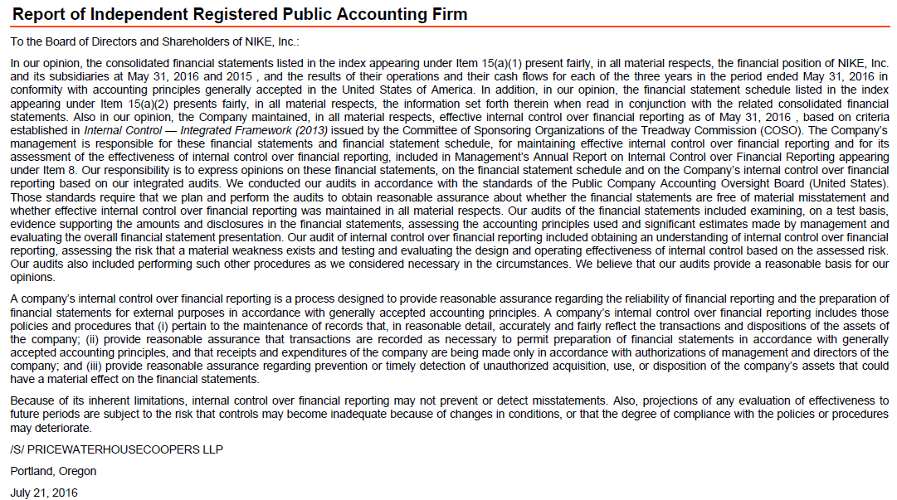
Form 10-K Annual Report
US GAAP & IFRS
Both use two basis to measure monetary amounts for balance sheets:
Historical Amount
Current Amount
Generally same wording
Notes:
After item 8 is what auditors have touched

Slide 9
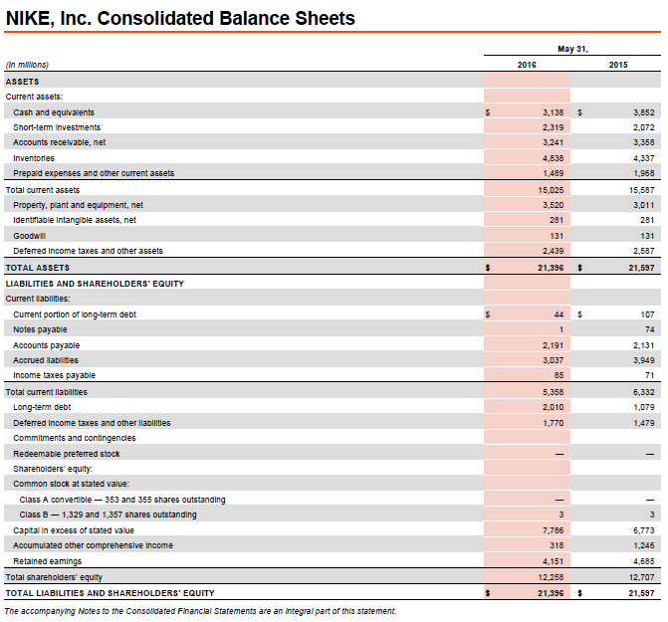
Assets = Liability + Shareholders’ Equity
There’s always two sides to every transaction

Slide 10
Practice Problem 1:
Lonski Company reports current assets of $500,000, noncurrent assets of $400,000, current liabilities of $200,000, and noncurrent liability of $200,000 at the conclusion of 2016. Compute the amount of shareholders’ equity on the balance sheet at the end of 2016.

Slide 11
Practice Problem 2:
The Isabel Company began operations on January 1, 2016. The company issued 1,000 shares of common stock for $84,000. On January 10, the company used $15,000 of the proceeds to purchase equipment and $12,000 to pay in advance for a two-year lease of a building beginning February 1, 2016. Rent is due on the 1st of each month. The company purchased $8,000 of inventory on account on January 15, agreeing to pay the seller within 30 days. Prepare Isabel’s balance sheet as of January 31, 2016.

Slide 12
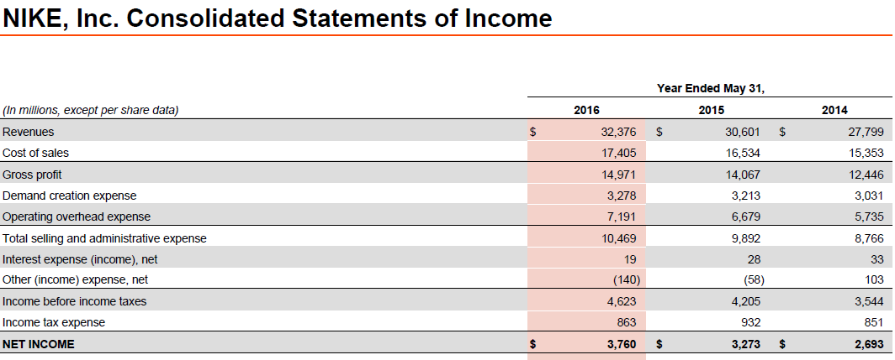
Practice Problem 3:
Income Statement
SkyHigh Balloons reported sales for the year ended December 31, 2016 of $2,700,000, costs of goods sold of $900,000, other operating expenses of $1,200,000, a gain of $10,000 on the sale of a delivery truck, interest expense of $56,000, and income taxes of $45,000. Compute SkyHigh’s net income for the year ended December 31, 2016. Prepare SkyHigh’s income statement for the year ended December 31, 2016.

Slide 13
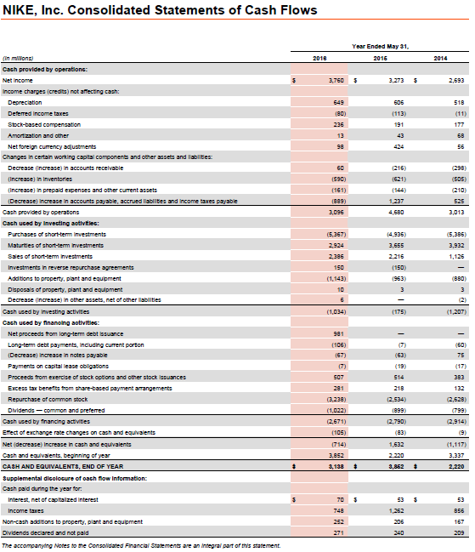

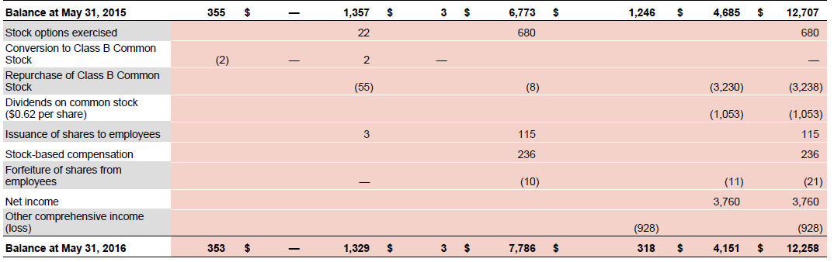

Slide 14
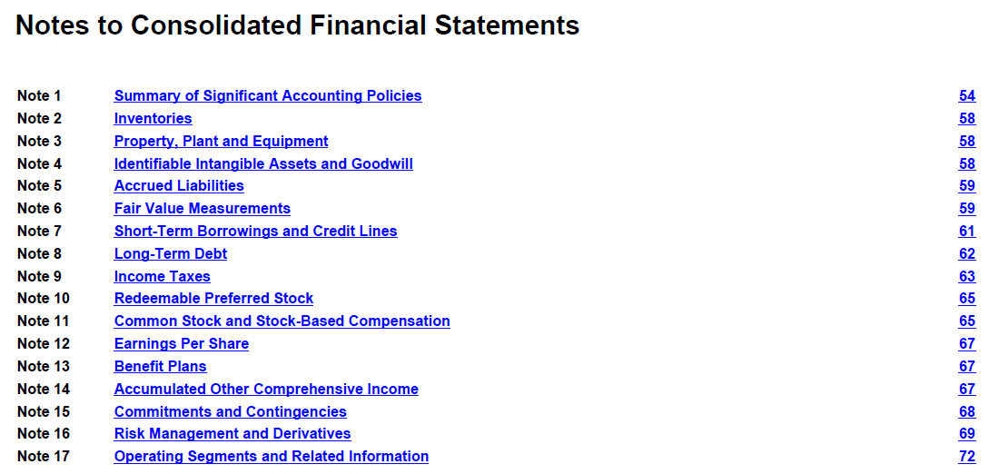
Practice Problem 4:
Barron Company earned net income of $190,000 during 2016. The retained earnings balance was $400,000 at January 1, 2016 and $560,000 at December 31, 2016. Compute the amount of dividends paid to shareholders during 2016.

Slide 15
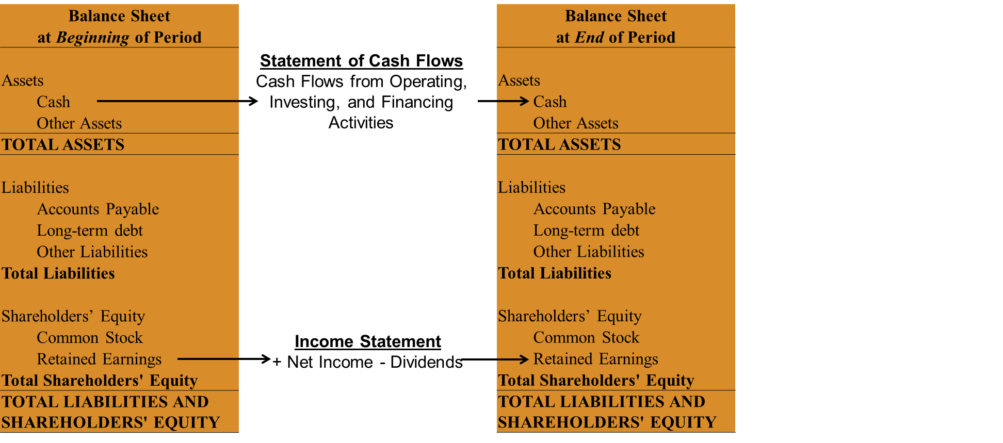

Slide 16
Accounting Methods
Cash Basis Accounting
Cash received – cash paid
Accrual Basis Accounting
Matching principle
Match expenses with the revenues they helped to generate
Income = Revenue – Expenses + Gains + Losses

Slide 17
Example 5:
NewKicks began operations on September 1. On September 5, the company received $120,000 of completed shoes from its manufacturers on account. NewKicks paid these manufacturers $60,000 in cash on September 25. During the month of September, NewKicks sold shoes to various department stores for a total of $310,000 in sales revenue. Of these sales, $260,000 were on credit and the rest were paid in cash. NewKicks collected $110,000 in cash related to the credit sales by the end of the month. On September 30, NewKicks had unsold finished goods inventory costing $30,000 remaining in its warehouse. Finally, NewKicks incurred and paid $24,000 in salary expense and $13,000 in rent expense during September.
Calculate net cash flow and net income for NewKicks. Which method of accounting better measures NewKicks operating performance?

